Slide 1
Exam question topics overview
1.Derive a transfer function for a dynamical system e.g. mechanical system Be able to write down differential equations of mechanical and electrical systems and applying Laplace transforms 2.Analyze a canonical 2nd order system analysis Compare with canonical equations and specify canonical parameters (damping, natural frequency, overshoot etc.) 3.Derive the state space model for a linear dynamical system Indicate if the system is stable, controllable and observable 4.Analyze a non-linear dynamical system Use linearization based on the Jacobian method to derive a linear state space model in matrix form 5.Design a state feedback controller Specify state feedback gain using pole/eigenvalue placement by algebraic manipulation by hand. 6.Observer and integral control Understand these concepts and how to implement them 7.Design an optimal feedback controller Specify state feedback gain using Algebraic ricotta equations

Slide 2
ROCO218: Control Engineering Dr Ian Howard Tutorial 4 ROCO218 2016 Exam examples Derive transfer function for mechanical system

Slide 3
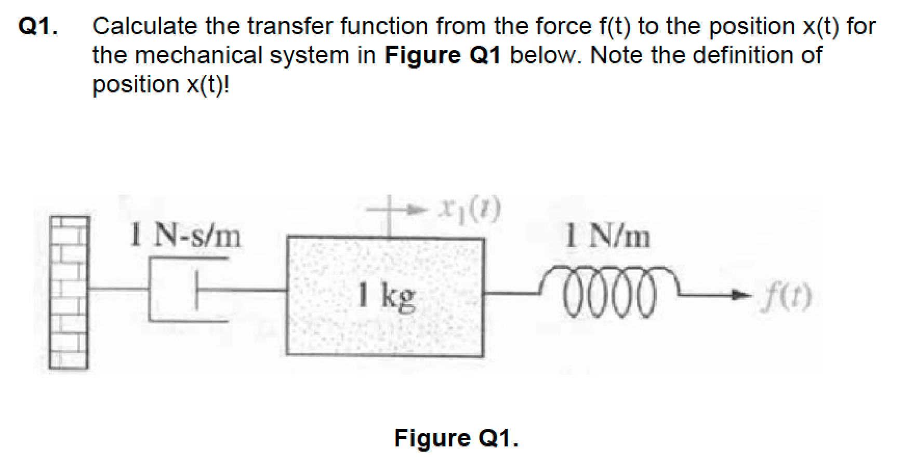
Q1: Mechanical system

Slide 4
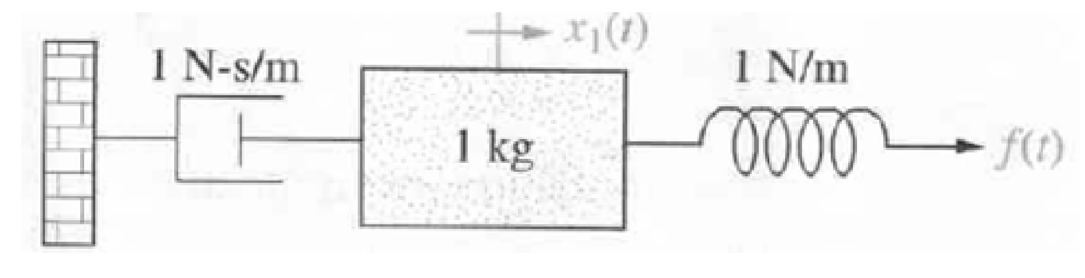
Q1: Mechanical system
The spring has no effect on position x(t), since the force f(t) is simply transmitted through the spring to the mass (Newton’s 1st law).
The differential equation that describes the motion of the mass therefore doesn’t involve a term for the spring:
Taking the Laplace transform with zero initial conditions
Inserting m = 1, μ = 1.
Therefore transfer function from F(s) to X(s)

Slide 5
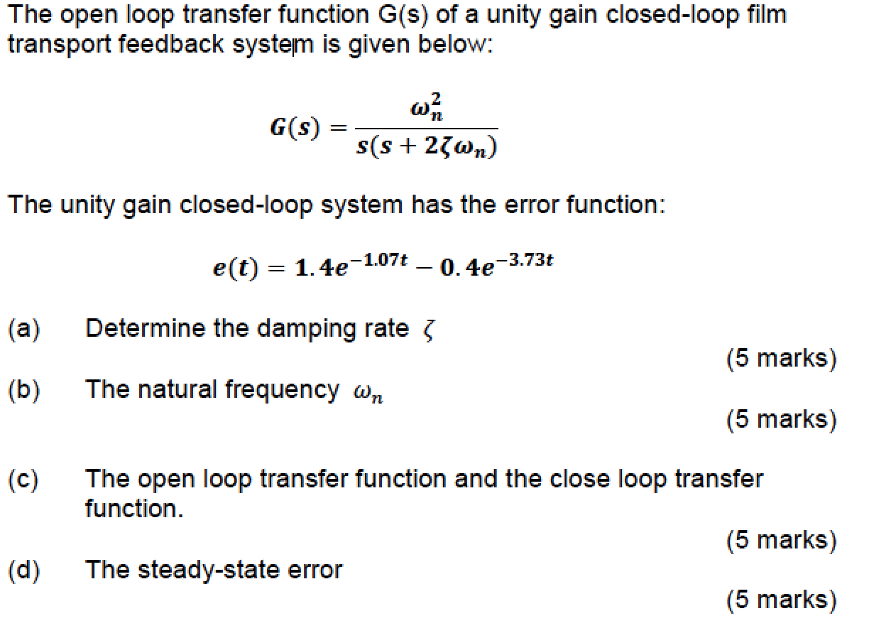
Q2: Example canonical 2nd order system

Slide 6
Q2: Example canonical 2nd order system
Given the open loop function
The unity feedback closed loop transfer function C(s) is therefore given by
Substituting in open loop transfer function gives

Slide 7
Q2: Example canonical 2nd order system
In the time domain the error response is
Using the Laplace transform
e(t) in the s-domain it is give by
Now combine both terms together over common denominator
After rounding the values

Slide 8
Q2: Example canonical 2nd order system
The error E(s) is the difference between input and output
For the closed loop system the error E(s) is given by
Where T(s) is the closed loop transfer function.
Substituting the closed loop transfer function we derived previously
Where
Damping is ξ
Natural frequency is ω_{n}
This is written in a
canonical 2nd order form

Slide 9
Q2: Example canonical 2nd order system
Comparing the error function of our system with the desired error response for step input which sets R(s)=1/s
By comparing coefficients:
4=ω²_{n.} Therefore natural frequency ω_{n} = 2.0
4.8=2ξ2 Therefore damping ξ = 1.2
open loop transfer function is therefore
closed loop transfer function is therefore

Slide 10
Q2: Example canonical 2nd order system
From the given error function
Steady state error is when t tends to infinity
So Steady state error goes to to zero as t goes to infinity

Slide 11
ROCO218: Control Engineering Dr Ian Howard Tutorial 4 2015R exam for ROCO316 Modern Control Solutions to relevant questions

Slide 12
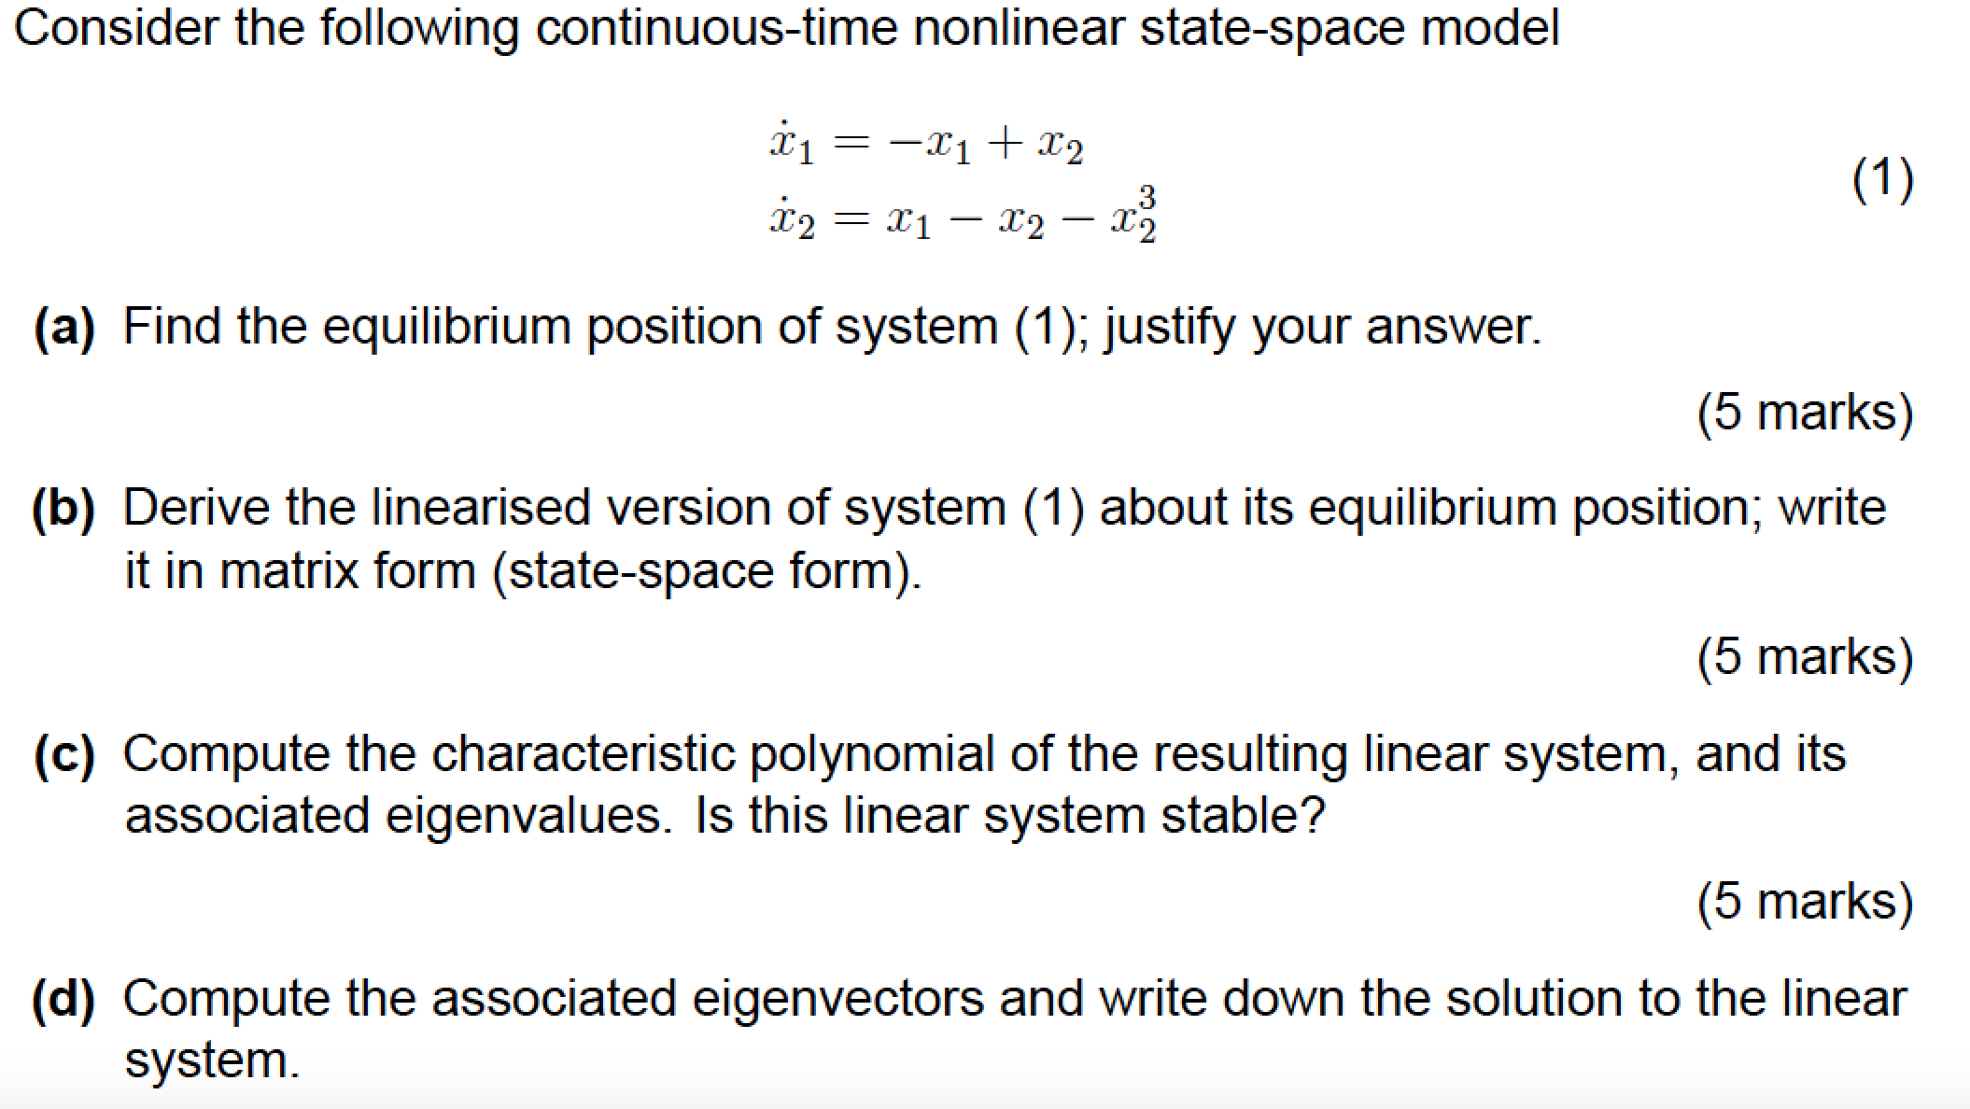
Q1: Continuous-time nonlinear control system

Slide 13
Q1: Continuous-time nonlinear control system
Equilibria occur when the system us stationary
To find the equilibria we must therefore solve the equations
Substituting in
Therefore, the only equilibrium position of system (1) is (x1, x2) = (0; 0)
To linearize the system at this point we need to evaluate the Jacobian at this point
From the state equations we can write

Slide 14
Q1: Continuous-time nonlinear control system
Given these two functions
The Jacobian of the system is a 2x2 matrix since we have 2 state variables
Taking partial derivatives w.r.t. to state variables
Evaluating at (0,0)

Slide 15
Q1: Continuous-time nonlinear control system
The Jacobian
Has the associated linear system
The characteristic polynomial is found by finding the eigenvalues λ of the Jacobian matrix which is achieved by solving the equation
Where X are the corresponding eigenvectors
If the term
has an inverse then
This is the trivial solution!
However we get a non-trivial solution when the Jacobian term has no inverse, which occurs when

Slide 16
Q1: Continuous-time nonlinear control system
Expanding out the expression
For a 2x2 matrix the determinant is given by
Characteristic equation is therefore
Factorizing given
Since have one eigenvalue with a zero real value, although the other has a negative real value, the system is only marginally stable

Slide 17
Q1: Continuous-time nonlinear control system
The eigenvectors X and eigenvalues λ satisfy the equation
For the eigenvalue λ=-2
Multiplying out terms gives
Both show
For the eigenvalue λ=0
Multiplying out terms gives
Both show

Slide 18
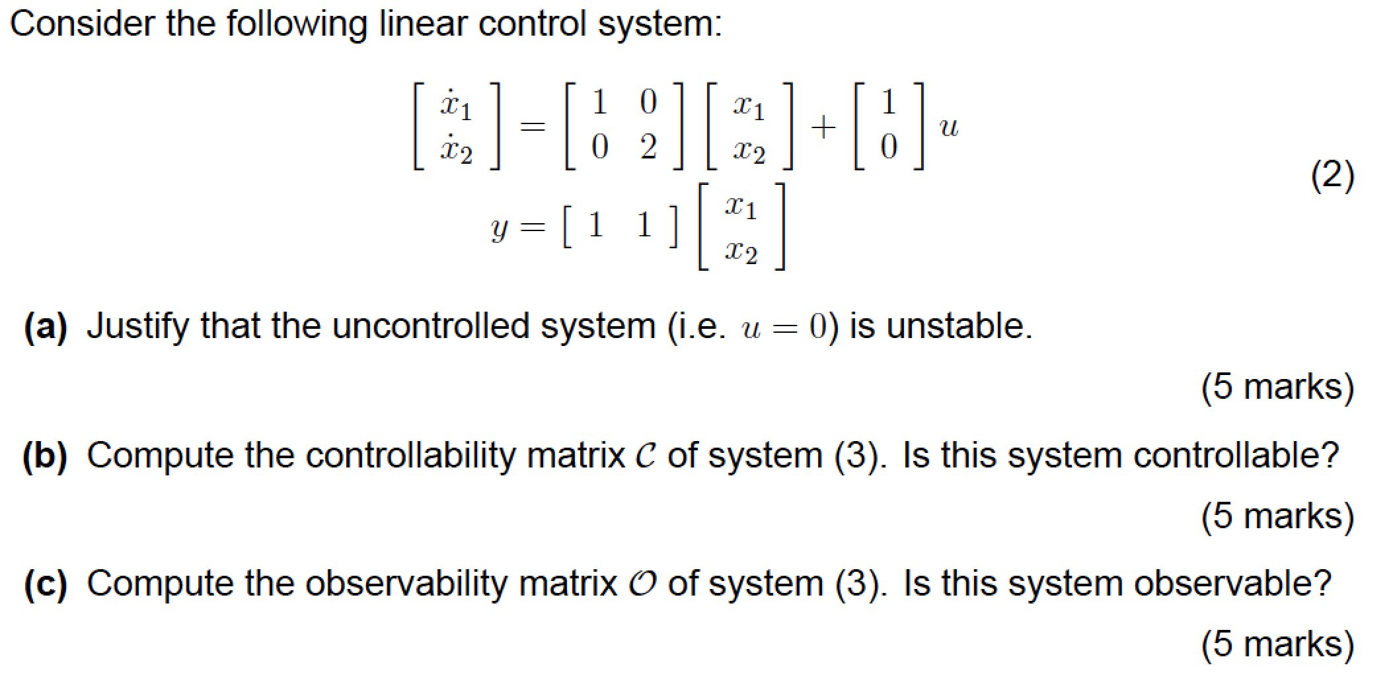
Q2: State space analysis

Slide 19
Q2: State space analysis
State space equations take the form
The given system state space equations are
Therefore the system matrices are
Therefore the since system matrix A is diagonal, by inspection we can see that the eigenvalues of the system are given the diagonal elements of the system matrix A
Therefore λ = 1,2
However we will proceed and adopt an analysis here that will deal with the general case

Slide 20
Q2: State space analysis
Given system matrix A
The eigenvalues of matrix A must satisfy the equation
Where X is the state vector
Where I is the identity matrix
This equation has a non-zero solution X if and only if the determinant of the matrix (A-I)=0
Where straight bracket signifies the determinant

Slide 21
Q2: State space analysis
Substituting A and I into the expression
For a 2x2 matrix the determinant is given by
Both of these eigenvalues are strictly positive and therefore the open loop system is unstable

Slide 22
Q2: State space analysis
Since our system has a 2x2 system matrix, the system controllability is given by
Calculating the AB term gives
It can be seen directly that the (reduced echelon form) matrix only has rank of 1
Therefore the system is not controllable

Slide 23
Q2: State space analysis
Since our system has a 2x2 system matrix, the system observability matrix is given by
Calculating the CA term gives
Using Gaussian elimination to try to achieve echelon form
It can be seen that the reduced echelon form matrix has rank of 2, so the system is observable

Slide 24
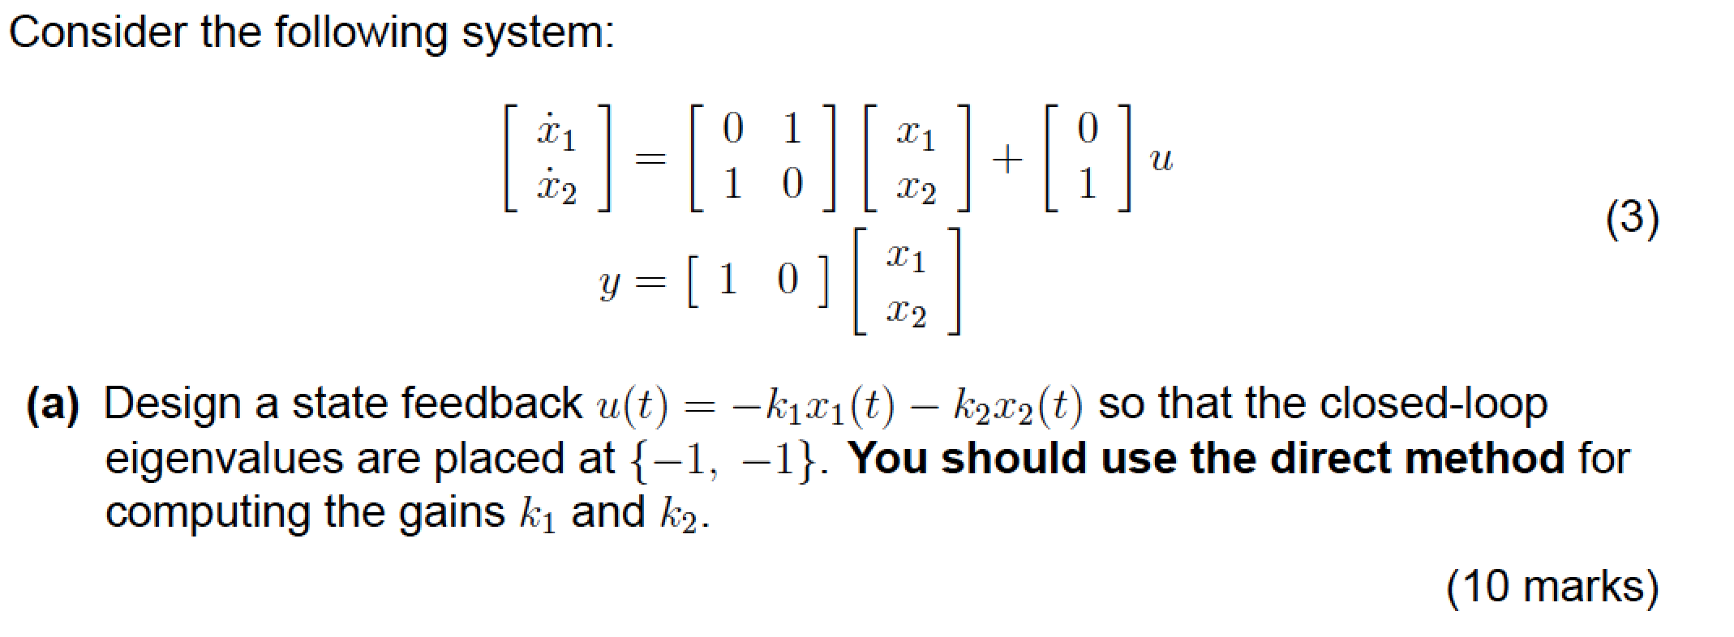
Q3: State space control

Slide 25
Q2: State space analysis
State space equations take the form
The given system state space equations are
Therefore the system matrices are

Slide 26
Q2: State space analysis
We now apply feedback to the state space equation
This is achieved by setting the input U to
Where the gain vector is given by
This leads to the the modified system dynamics equation
So the stability of the feedback system is determined by location of its poles which are the eigenvalue of the matrix (A-BK)
The eigenvalues λ of the closed loop system are thus given by

Slide 27
Q2: State space analysis
Using the system matrices
Substituting in values
The characteristic equation is therefore

Slide 28
Q2: State space analysis
Simplifying the characteristic equation
We require that the eigenvalues λ of the controller system are at -1,-1
Therefore we want the following characteristic equation
We now need to match the coefficients in the desired eigenvalues characteristic equation using the appropriate gains k₁ and k₂ therefore:
Feedback law is therefore

